Slide 1
Sexual assault on Mexico city
ERIK DELGADILLO
IBM/COURSERA CAPSTONE
JANUARY 2020

Slide 2
UNRAVELING AND MAPING THE INFO.
A high ammount of information is available but not many people understand it or is not as palpable as we want.
Data acquisition.
the public data base of all the opened investigations by the Justice Department A.K.A "Procuraduria General de justicia" with URL: https://datos.cdmx.gob.mx/explore/dataset/carpetas-de-investigacion-pgj-de-la-ciudad-de-mexico/table/?disjunctive.ao_hechos&disjunctive.delito
Geojson file with the exact location and delimitation of all the CDMX boroughs with URL: https://datos.cdmx.gob.mx/explore/dataset/alcaldias/table/
Database of the reprted crimes with known adresses and an aggregate of "Latitude" and "Longitude" obtained for the previous wrangled API consult*

Slide 3
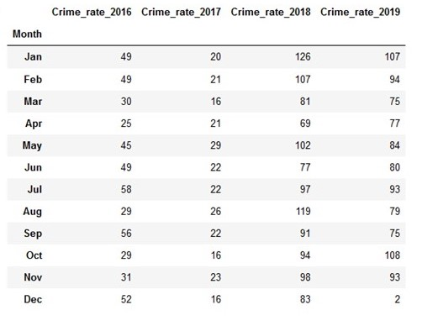
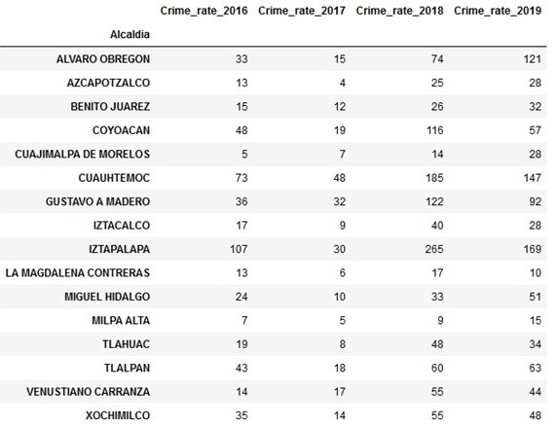
Cleaned and operative dataframes
Dataframe: Occurrence by month
Dataframe: Occurrence by Borough

Slide 4
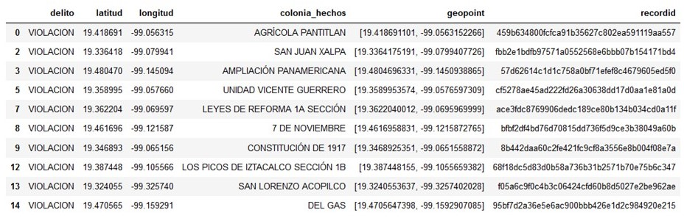
Cleaned and operative databases
Dataframe: Exact location of crime on year 2019

Slide 5
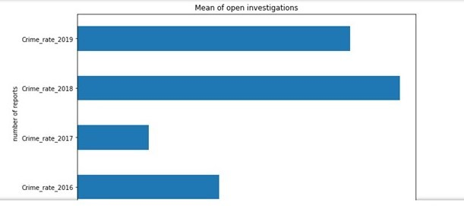
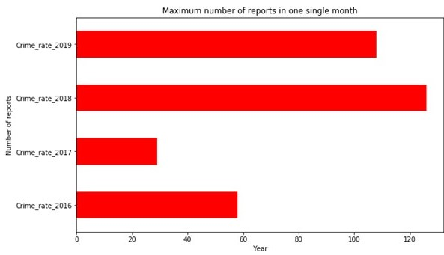
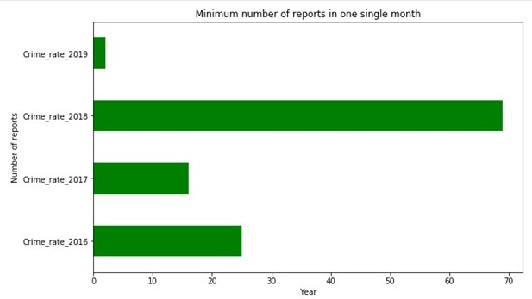
Visual Analysis
Satistics by month and Year:
Monthly mean of open investigations.
Month with highest number of reports.
Month with lowest number of reports.

Slide 6
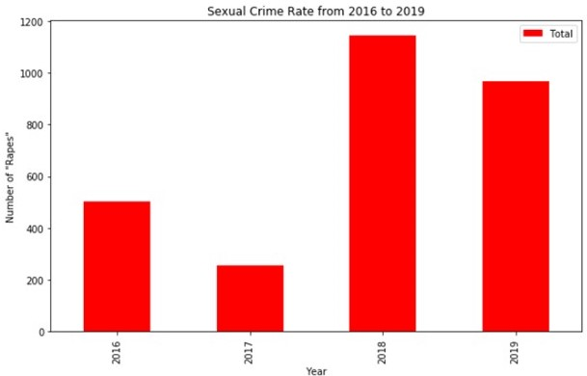
Visual Analysis :Behavior by Year

Slide 7
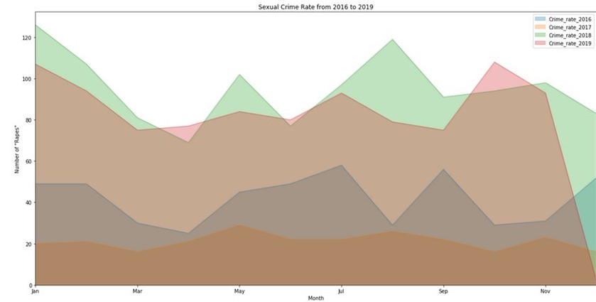
Visual Analysis :Behavior by Month

Slide 8
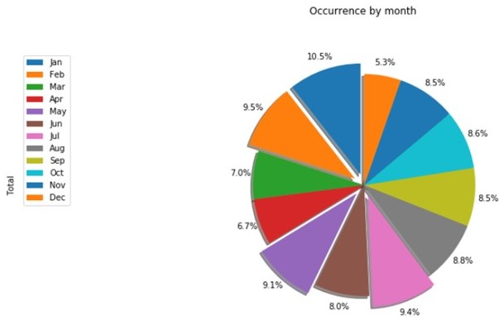
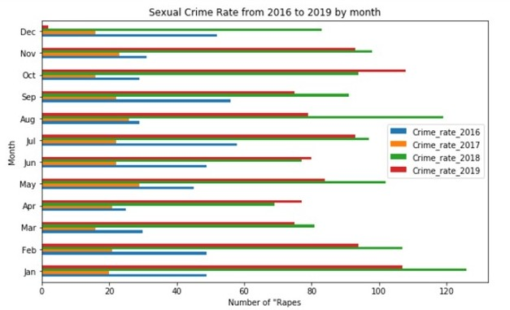
Visual Analysis :Behavior by Month

Slide 9
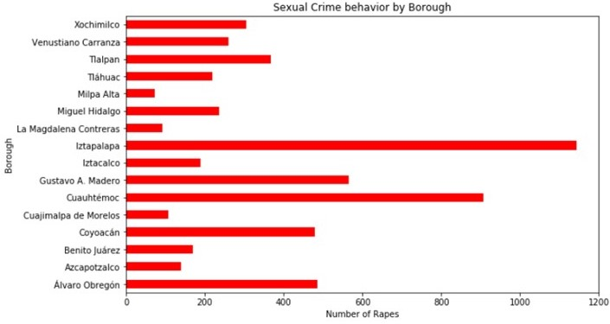
Visual Analysis :Behavior by Borough cumulative

Slide 10
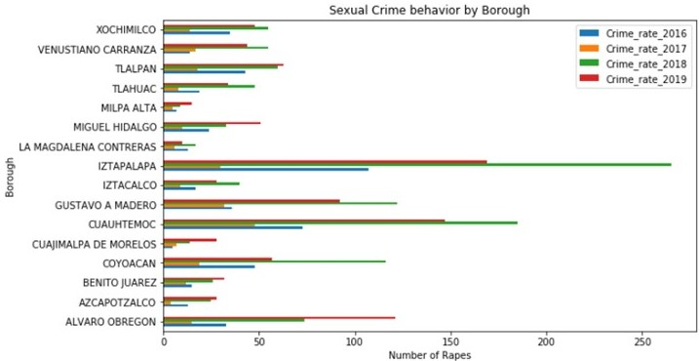
Visual Analysis :Behavior by Borough

Slide 11
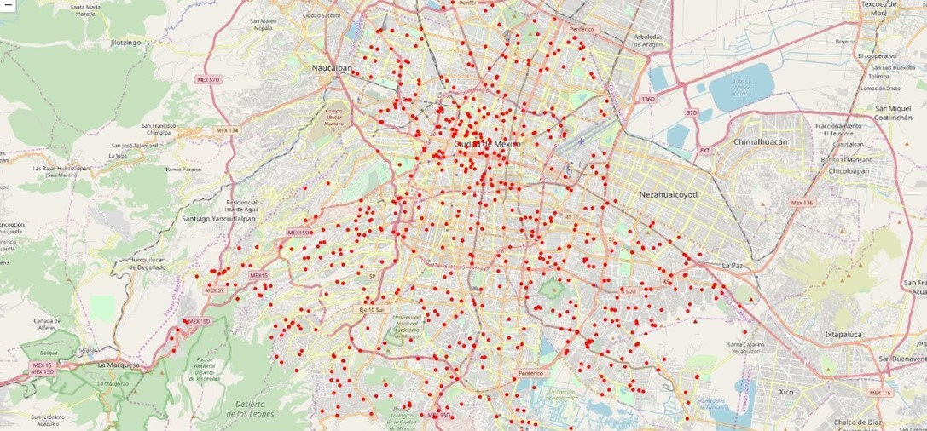
Visual Analysis : Maping the occurrence

Slide 12
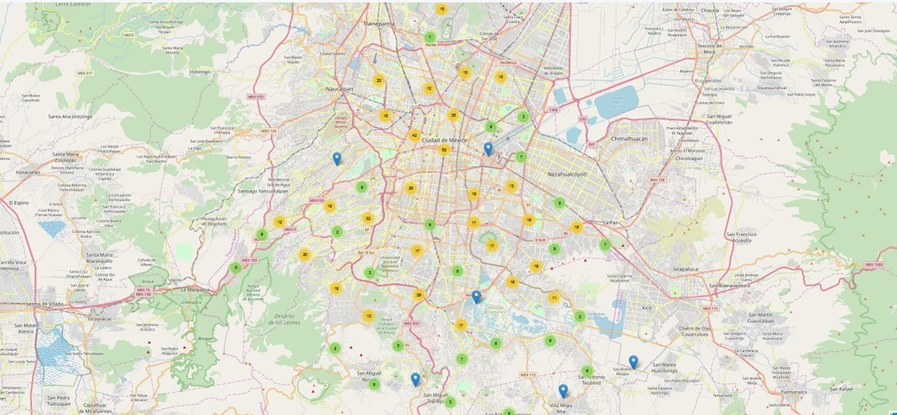
Visual Analysis : Clustering the occurrence

Slide 13
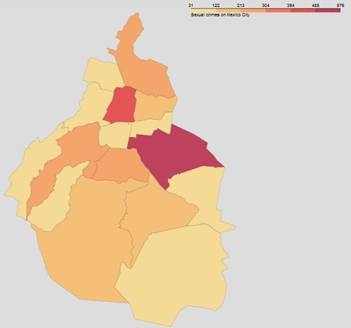
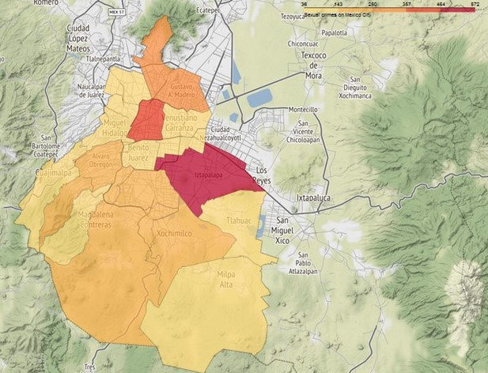
Choropleth map by borough (interactive map)
Jupyter Notebook.

Slide 14
Conclusions:
Our analysis shows that the Sexual Assault crime has had a constant and continuous grow through the last 5 years.
We can see on charts that the year 2018 was by far the most dangerous year of the past lustrum, we now have clear insights that "Iztapalapa", "Cuahutemoc and "Alvaro Obregon" are the 3 most dangerous "Boroughs" of the entire city, it is not a coincidence that the 3 of them are on the northeast side of the city, adjoining "Estado de México" another well known "High risk Mexican state.
By plotting the "point" map, I personally felt concerned about that almost all Neighborhoods had at least one open investigation on Sexual assault speaking only of the past year 2019.
Thanks to the arrangements made by Governor Claudia Sheinbaum in addition to many non-pacific protests around the city summoned by the pro-feminist groups, a reduction on the occurrence was “immediately reflected” on December 2019 when only 2 open investigations were considered on the category of "rape".

